Slide 1
Placement in a
Post-AB 705 World
Craig Hayward, PhD
John Hetts, PhD
AB 705 Work Group
Wednesday, February 7, 2018
California State University Chancellor’s Office
Long Beach

Slide 2
Agenda
Requirements of AB 705
Review of MMAP and Results to Date
Adapting MMAP to AB 705
Self-Reported Data and Durability of GPA
Discussion
Notes:
Craig

Slide 3
AB 705 (Irwin) requirements
Use of high school performance data
Use of “highly unlikely” standard
Optimize student’s probability of completing transfer-level English and math* in their first year
Optimize student’s probability of completing ESL sequence in three years
*Or intermediate algebra if that is the graduation requirement for the student’s program of study or educational goal
Notes:
Craig – Must use high school performance data (e.g., GPA, coursework, and/or course grades); Must show that a student is “highly unlikely” to succeed in transfer-level or college-level classes before being allowed to place that student in remediation that will extend their time to completion.

Slide 4
Review of the Multiple Measures Assessment Project (MMAP)
Notes:
Craig

Slide 5
Data Set for the Models
CCC students enrolled in an English, Math, Reading or ESL class with matching high school data in Cal-PASS Plus
  ≈1 M cases for Math & English; ≈200k for Reading & ESL
Bulk of data from 2008 through 2014
Rules built from students with 4 years of high school data (≈25% of sample)
  70% probability of success or higher required for transfer placement
MMAP code (http://bit.ly/MMAP_code)
R Tutorial (http://bit.ly/R_Tutorial)
Notes:
Craig
High school data has a long tail where there are some schools with older high school data. English training sample=217k; Math=143k; Reading=51k; ESL=37k (esp. small b/c so many HS ESL students do not enroll in ESL when they come to college.. Used May 2015 data files for Math & English; July 2015 data file for Reading; and January 2016 data file for ESL.

Slide 6
Variables Explored in the Models
High school unweighted cumulative GPA
Grades in high school courses
CST scores
Advanced Placement (AP) course taking
Taking higher level courses
Delay between high school and community college
HS English types (expository, remedial, ESL)
HS math level (Elem Algebra, Integrated Algebra, Pre-Calculus)
Notes:
Craig

Slide 7
Transfer-Level Placement Recommendations
Transfer Level Course | Direct Matriculant | Non-Direct Matriculant
College Algebra (STEM) Passed Algebra II (or better) | HS 11 GPA >=3.2 OR HS 11 GPA >=2.9 AND Pre-Calculus C (or better) | HS 12 GPA >=3.2 OR HS 12 GPA >=3.0 AND Pre-Calculus or Statistics (C or better)
Statistics (General Education/Liberal Arts) Passed Algebra I (or better) | HS 11 GPA >=3.0 OR HS 11 GPA >=2.3 AND Pre-Calculus C (or better) | HS 12 GPA >=3.0 OR HS 12 GPA >=2.6 AND Pre-Calculus (C or better)
English | HS 11 GPA >=2.6 | HS 12 GPA >=2.6
http://bit.ly/RulesMMAP
Notes:
Craig

Slide 8
Transitions and Intersegmental Trust
Within systems: highly reliable student progression within a sequence after successful completion (C or better)
HS to CCC transition:
  >3/4 repeat one or more levels of math successfully completed in HS
  ~1/2 repeat ≥ 2 levels of math
  African Americans & Hispanics are ~ 60% more likely to repeat
  Female students are ~20% more likely to repeat levels
Notes:
Avg. GPA – 3.2 - Disproportionately likely to repeat, go backwards
Even after success!
Standardized tests frequent gatekeeper/proxy
Repetition yields _at best_ moderate improvement in performance in repeated and subsequent course
Disproportionate impact on underrepresented populations
Substantial real and opportunity costs to repeat courses successfully completed

Slide 9
Predictive Validity: GPA vs. Test
Notes:
John

Slide 10
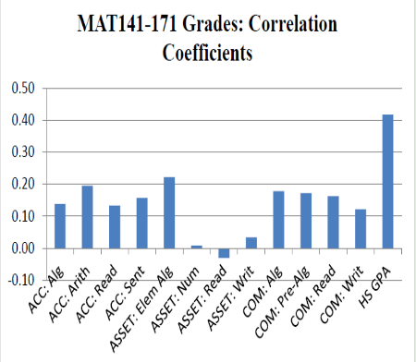
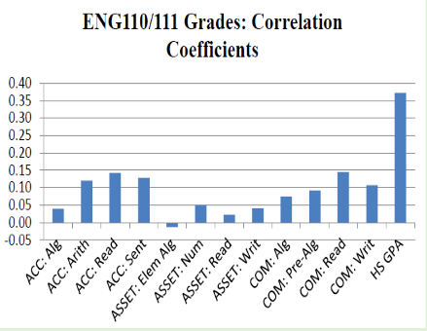
Compass, Accuplacer, Asset – North Carolina
From Bostian (2016), North Carolina Waves GPA Wand, Students Magically College Ready adapted from research of Belfield & Crosta, 2012 – see also Table 1)

Slide 11
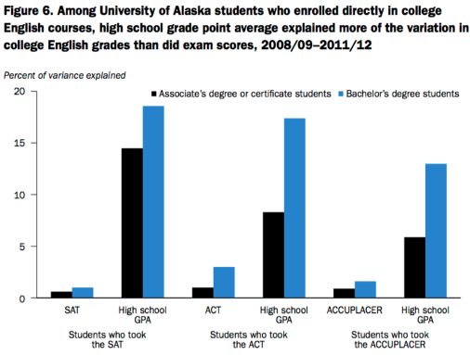
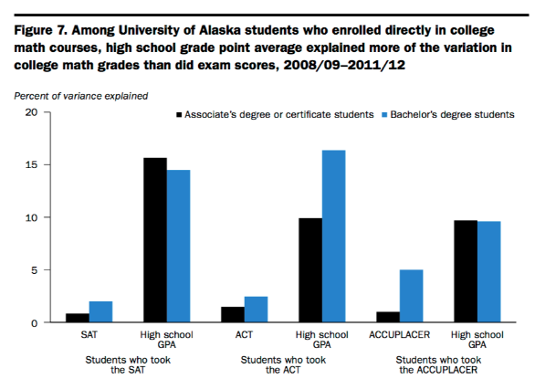
Accuplacer, SAT, ACT - Alaska
From Hodara, M., & Cox, M. (2016), Developmental education and college readiness at the University of Alaska: http://bit.ly/HSGPAAK

Slide 12
California Community Colleges Data
Predicting English Success by Level
Predicting Math Success by Level
Notes:
John

Slide 13
Results from the Field
Notes:
John

Slide 14
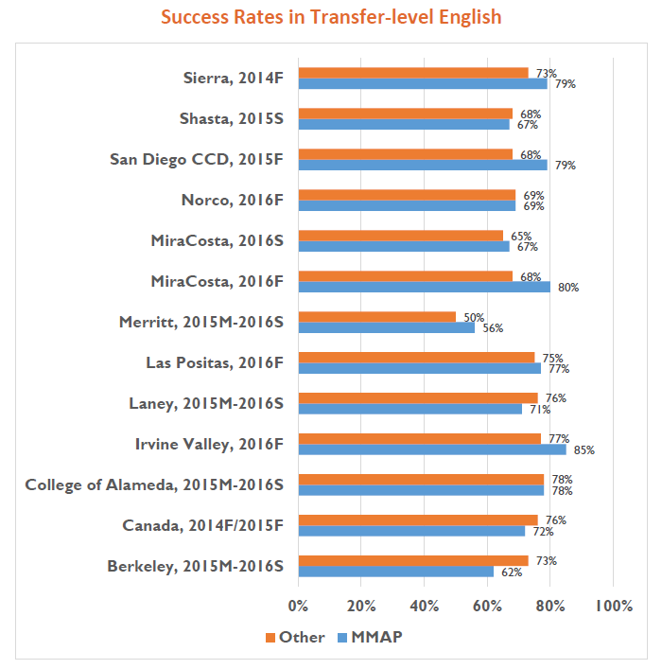
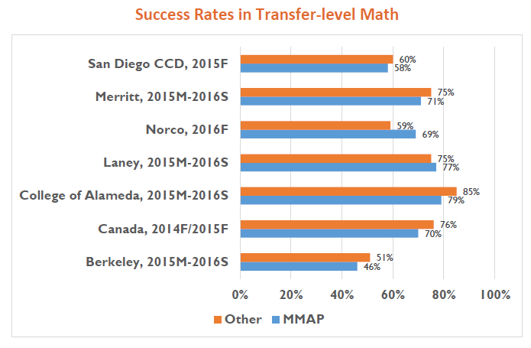
bit.ly/MMAPSummary2017
Notes:
John to revise… An average 0% difference in success rates for math

Slide 15
Change in Transfer-Level Success After MMAP Implementation
Average Change in Math Success Rates
0%
Average Change in English Success Rates
+2%
Notes:
Data from eight colleges for math; 12 colleges for English

Slide 16
English throughput comparisons
 | Transfer-level success rates |  |  | 2 year cohort completion rates
 | Traditional placement into transfer-level | MMAP | Difference | 1 level below placement | Difference b/w MMAP & trad. sequence | 2 levels below placement | Difference b/w MMAP & trad. sequence
Alameda* (2015-2016) | 78% | 78% | 0% | 29% | 49%
Berkeley (2015-2016) | 73% | 62% | -11% | 60% | 2% | 38% | 24%
Cañada+ (2014-2015) | 76% | 72% | -4%
Irvine Valley (2016F) | 77% | 85% | 8% | 68% | 17% | 54% | 31%
Laney* (2015-2016) | 76% | 71% | -5% | 29% | 42%
Las Positas (2016F) | 75% | 77% | 2% | 65% | 12% | 32% | 45%
Merritt* (2015-2016) | 50% | 56% | 6% | 29% | 27%
Mira Costa (2016F) | 68% | 80% | 12% | 56% | 24% | 36% | 44%
Norco (2016F) | 69% | 69% | 0% | 47% | 22% | 32% | 37%
SDCCD^ (2015F) | 68% | 79% | 11%
Shasta (2015S) | 68% | 67% | -1% | 32% | 35%
Sierra (2014F) | 73% | 79% | 6% | 44% | 35% | 22% | 57%
Average |  |  | 2% |  | 26% |  | 40%
*(average excluding Alameda, Laney, & Merritt) |  |  |  |  | *21%
Notes: Success rates from MMAP Summary of Pilot College Results, throughput for students 1-2 levels below from CCCCO Basic Skills Cohort Progress Tracker from year prior
*Alameda, Laney, & Merritt have different structure at 1-2 levels below, +Cañada’s transfer-level courses appear miscoded in 2015-2016, ^SDCCD implementation was at district level - cohort progress tracker n/a at district level.

Slide 17
Math Throughput Comparisons
 | Transfer-level success rates |  |  | 2 year cohort completion rates
 | Traditional | MMAP | Difference | 1 level below | Difference b/w MMAP & trad. sequence | 2 levels below | Difference b/w MMAP & trad. sequence
Alameda (2015-2016) | 85% | 79% | -6% | 28% | 51% | 17% | 62%
Berkeley (2015-2016) | 51% | 46% | -5% | 23% | 23% | 15% | 31%
Cabrillo College (F2017) | 56% | 68% | 12% | 35% | 33% | 13% | 55%
Cañada+ (2014-2015) | 76% | 70% | -6%
Laney (2015-2016) | 75% | 77% | 2% | 21% | 56% | 14% | 63%
Merritt (2015-2016) | 75% | 71% | -4% | 21% | 50% | 18% | 53%
Norco (2016F) | 59% | 69% | 10% | 37% | 32% | 17% | 52%
SDCCD^ (2015F) | 60% | 58% | -2%
Average |  |  | 0% |  | 41% |  | 53%
Notes: Success rates from MMAP Summary of Pilot College Results, throughput for students 1-2 levels below from CCCCO Basic Skills Cohort Progress Tracker from year prior
*Alameda, Laney, & Merritt have different structure at 1-2 levels below, +Cañada’s transfer-level courses appear miscoded in 2015-2016, ^SDCCD implementation was at district level - cohort progress tracker n/a at district level.

Slide 18
Summary of Differences Between Students Placed Traditionally and Students Placed by MMAP
Mathematics
English
Comparison Group | Comparison | Difference
Students placed directly into transfer-level by existing method in same term | Success rates | MMAP success rates equal
Students placed 1 level below in previous year | Completion of transfer-level math in 2 years | MMAP throughput 41 percentage points higher
Students placed 2 levels below in previous year | Completion of transfer-level math in 2 years | MMAP throughput 53 percentage points higher
Comparison Group | Comparison | Difference
Students placed directly into transfer level by existing method in same term | Success rates | MMAP success rates 2 percentage points higher
Students placed 1 level below in previous year | Completion of transfer-level English in 2 years | MMAP throughput 26 percentage points higher
Students placed 2 levels below in previous year | Completion of transfer-level English in 2 years | MMAP throughput 40 percentage points higher

Slide 19
Overall Summary
  MMAP rules performing as expected
  Success rates of students placed by MMAP are just as high as students placed directly into transfer-level using the institutions traditional placement method
    even though MMAP placement doubles to quintuples placement into transfer level courses
  Successful completion of the transfer level course (throughput) is 20 (English) to 40 (Math) percentage points higher compared to students placed even just one level below in previous year.
  Placement messaging should be done once with a single voice and specifically state the recommended course
  Implementation of MMAP rules is nuanced
    For example, don’t use statistics rules to place into trigonometry or precalculus
  Collaboration between high schools and colleges has increased
Notes:
Mallory

Slide 20
Adapting MMAP to AB 705
It’s all about throughput.
Notes:
John

Slide 21
Adapting MMAP to AB 705
MMAP decision trees were based on identifying students who were highly likely to be successful
  At least 70% probability of success in transfer-level
Now, students can only be assigned to remediation if:
  They are highly unlikely to succeed at the transfer-level class
  AND
  Remediation maximizes their probability of throughput

Slide 22
What is a “Throughput Rate”?
The probability of getting to and through a gateway course within a specified period of time.
Throughput rate (AB 705): The proportion of a cohort of students who complete the transferable or gateway math or English course within two primary semesters or three primary quarters of entering their first course in the sequence.

Slide 23
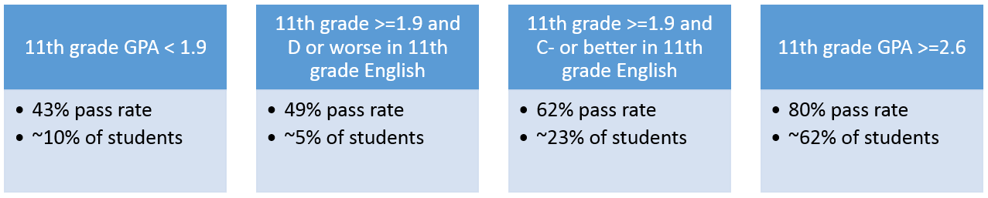
Transfer-Level English Throughput Rates
Notes:
Decision rules based on the English 1A decision tree for direct matriculants

Slide 24
Maximizing Throughput: English

Slide 25
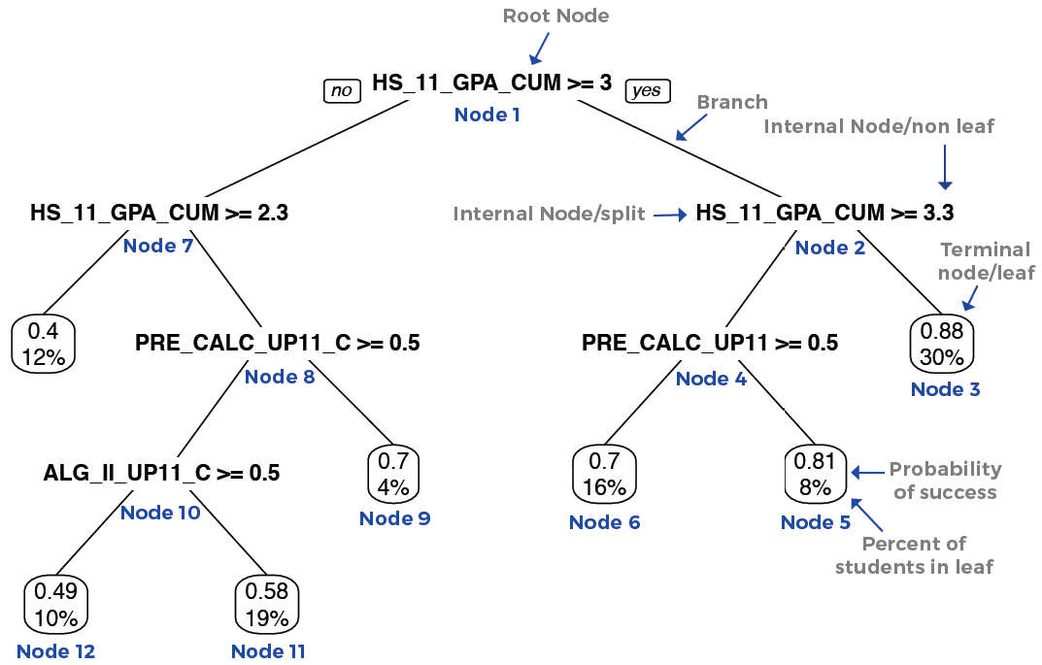
Statistics Decision Tree

Slide 26
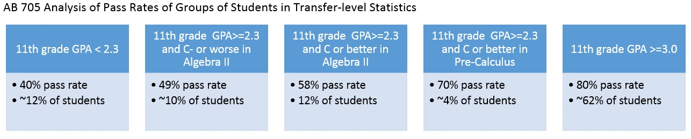
Statistics Throughput Rates

Slide 27
Maximizing Throughput: Statistics
Notes:
Adjusted to remove those whose intent was to get a one-level below gateway math course.

Slide 28
The BSTEM ‘Intent Cohort’
Which students intend to pursue a calculus-oriented Business-STEM math pathway from one-level below?
Some students have a goal of a terminal associate’s degree and one-level below satisfies their requirement
Some students intend to pursue a Statistics or Liberal Arts Math pathway
How to distinguish intent?

Slide 29
Identifying the Intent Cohort
Terminal AA/AS, Certificate, etc. (11.6%)

Slide 30
The BSTEM ‘Intent Cohort’
Remove those with a non-transfer educational goal (11.6%)
Remove those on the SLAM path
  Of those who progress to transfer-level math, 75% take SLAM vs. Precalculus, Calculus, Trig., or Business Calculus
  Reduce remaining one-level below starting cohort by 75%
Product of this process is the BSTEM intent cohort
  This will be the denominator for BSTEM throughput rates
  The denominator is reduced to 3,624 from 14,499
Notes:
College Algebra is removed from the SLAM vs. BSTEM ratio calculation because many SLAM students as well as BSTEM students are directed in College Algebra as a common transfer-level math. Therefore, enrollment in College Algebra does not serve to distinguish intent. A 2012 NCES study of the BPS cohort found that 20% of community college students have STEM majors, corroboration the 25% proportion found in this sample.

Slide 31
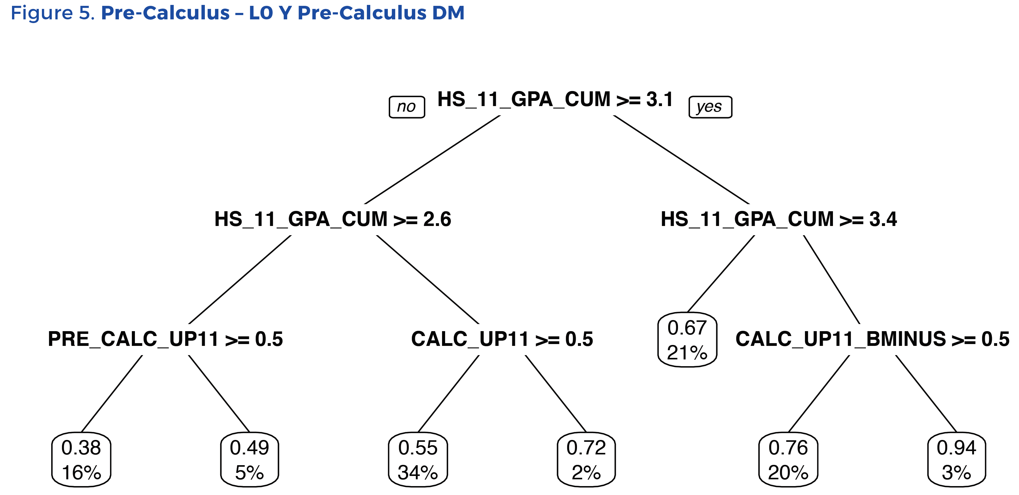

Slide 32
Pre-Calculus Throughput Rates
11th grade GPA < 2.6 and no Precalc. in HS
38% pass rate
~16% of students
11th grade GPA < 2.6 with Precalculus in HS
49% pass rate
~5% of students
11th grade GPA>=3.1 and < 3.4
67% pass rate
11th grade GPA >=3.4
78% pass rate
~23% of students
~21% of students
11th grade GPA>=2.6 and < 3.1
56% pass rate
~36% of students
AB 705 Analysis of Groups of Students in Precalculus

Slide 33
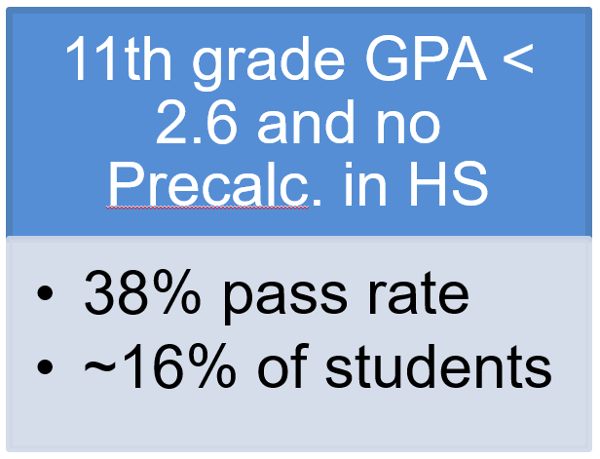
Maximizing Throughput: Pre-Calculus

Slide 34
Pre-Calculus Lowest Node
3,200 students with < 2.6 HSGPA and no precalculus in high school by grade 11 began at one-level below transfer math with intent to pursue a BSTEM path
  1,035 attempt a BSTEM class within one year (32.3%)
  453 are successful in any BSTEM class, including College Algebra (14.2%)
Throughput from one-level below into BSTEM is 14.2%
If placed directly into Precalculus, throughput is 38%
Notes:
28.6% of the cohort enroll in a BSTEM course within one year

Slide 35
38% pass rate? Are you serious?
While we may not be happy with a 38% probability of passing a transfer-level course, it represents students’ best shot at making it through the transfer-level work.
Co-requisite remediation is an option that has been used in other states and at Cuyamaca College to increase the pass rates (and throughput) of students with lower probabilities of academic success.
  http://bit.ly/CAPCuyamaca
  http://bit.ly/California_Coreq

Slide 36
Gateway Momentum in Math at Cuyamaca

Slide 37
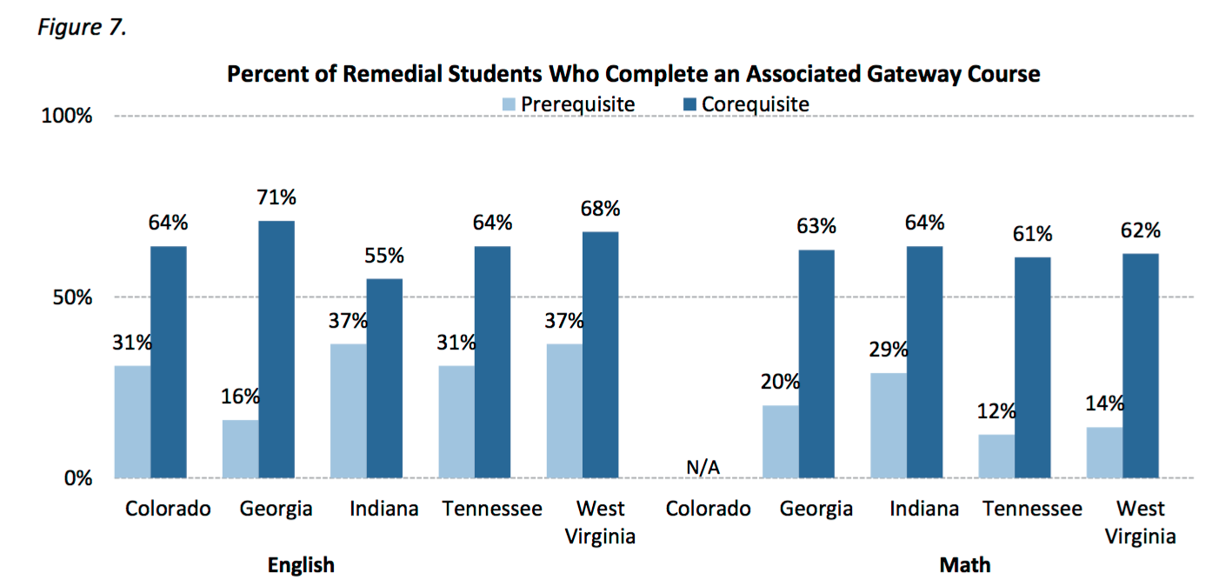
(In two years for prerequisite models, in first year for corequisites)
http://bit.ly/CCABridgeBuilders

Slide 38
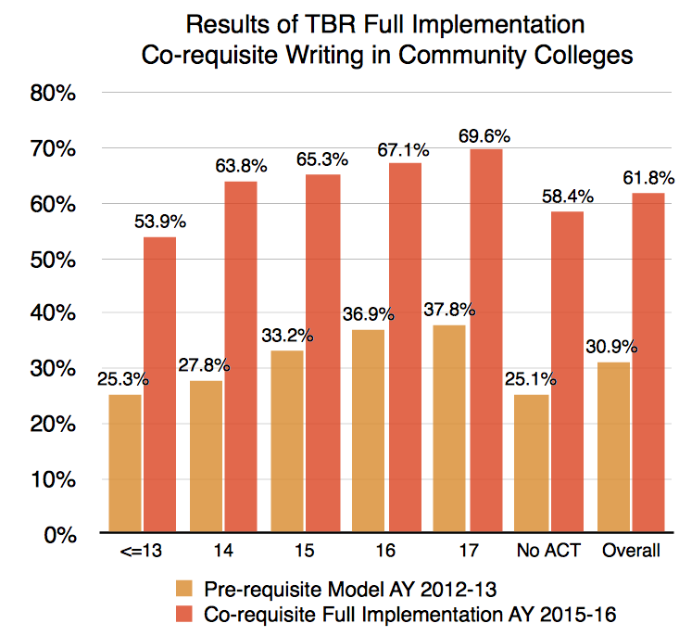
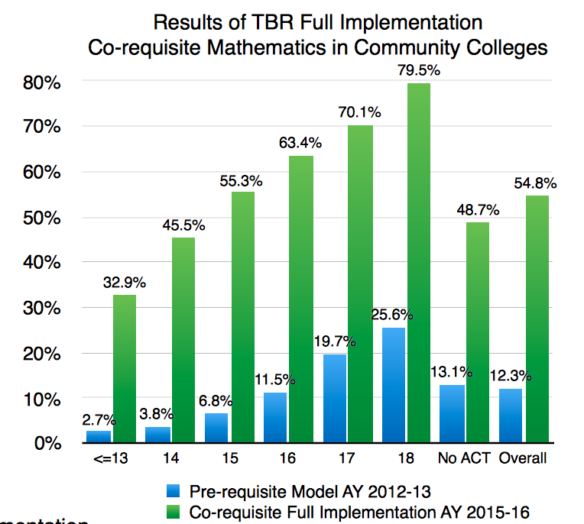
Successful Completion Within One Year vs. Corequisite Results by Testing Level - Tennessee
http://bit.ly/TNCoreq

Slide 39
Considerations on the use of GPA: Self-Report and Shelf Life

Slide 40
Self-Reported HSGPA as Potential Backup
UC & others uses self-report in admissions, verifying after admission
  2008: 9 campuses, 60000+ students. No campus had >5 discrepancies b/w reported grades and transcripts: bit.ly/UCSelfReportGPA
College Board: Shawn & Matten, 2009: “Students are quite accurate in reporting their HSGPA”, r(40,299) = .73: bit.ly/CBSRGPA
ACT brief found SR HSGPA to be highly correlated with students actual GPA: ACT, 2013: r(1,978) = .84 bit.ly/ACTSRGPA

Slide 41
GPA vs. Self-Reported HSGPA
HSGPA Level | N | Mean HSGPA |  | Mean diff.
 |  | Actual | Self-reported
3.50–4.00 | 599 | 3.79 | 3.75 | –0.04
3.00–3.49 | 451 | 3.24 | 3.23 | –0.01
2.50–2.99 | 408 | 2.81 | 2.76 | –0.05
2.00–2.49 | 265 | 2.24 | 2.35 | 0.11
1.50–1.99 | 172 | 1.77 | 2.04 | 0.27
0.00–1.49 | 85 | 1.03 | 1.85 | 0.82
Total | 1,980 | 2.95 | 3.02 | 0.07
ACT, 2013: bit.ly/ACTSRGPA
Notes:
It is possible that some of the differences we see between actual and student-reported HSGPA are due to differences in which course grades are included in each average.

Slide 42
Self-Reported High School Transcript Data
>70 CCCs are collecting self-reported data through Open CCCApply application
  Includes mix of pilot and non-pilot colleges
Working on analyzing validity of self-reported data in our system
  ERP just received full cut of CCC Apply data
Preliminary analysis on earlier data cut shows reasonable but (albeit not perfect) reliability between self-reported transcript data and actual transcripts
Notes:
Loris

Slide 43
Preliminary Self-Report Analysis
Overall strong correlation between self-reported high school GPA and actual GPA observed: r = .75 (n=12,048)
Lower GPA in ERP data less likely to correspond with self-report
Correspondence could be be improved by
  Encouraging students to have transcripts ready during application
  Suggesting that inaccurate information could invalidate application
Notes:
Loris

Slide 44
Preliminary Analysis: Medians
GPA vs. Self-Reported HSGPA – CCC Apply
HSGPA Level | N | Median HSGPA |  | Median diff.
 |  | Actual | Self-reported
3.50-4.00 | 2,600 | 3.69 | 3.80 | .11
3.00-3.49 | 4,026 | 3.23 | 3.40 | .17
2.50-2.99 | 4,203 | 2.75 | 3.00 | .25
2.00-2.49 | 3,645 | 2.26 | 2.70 | .44
1.50-1.99 | 2,327 | 1.79 | 2.50 | .71
0.00-1.49 | 869 | 1.30 | 2.20 | .90
Total | 17,670 | 2.74 | 3.00 | .26
Notes:
It is possible that some of the differences we see between actual and student-reported HSGPA are due to differences in which course grades are included in each average.

Slide 45
Decay Function of the Predictive Validity of High School GPA: Math

Slide 46
Decay Function of the Predictive Validity of High School GPA: English

Slide 47

Discussion

Slide 48
MMAP Research Team
Terrence Willett
The RP Group
twillett@rpgroup.org
Mallory Newell
The RP Group
newellmallory@deanza.edu
Craig Hayward
The RP Group
chayward@rpgroup.org
Kristen Fong
The RP Group
kfong@rpgroup.org
Rachel Baker
UC Irvine
rachelbb@uci.edu
Daniel Lamoree
Educational Results Partnership
dlamoree@edresults.org
Peter Bahr
University of Michigan
prbahr@umich.edu
John Hetts
Educational Results Partnership
jhetts@edresults.org
Ken Sorey
Educational Results Partnership
ken@edresults.org
‎
Notes:
Mallory

